Slide 1
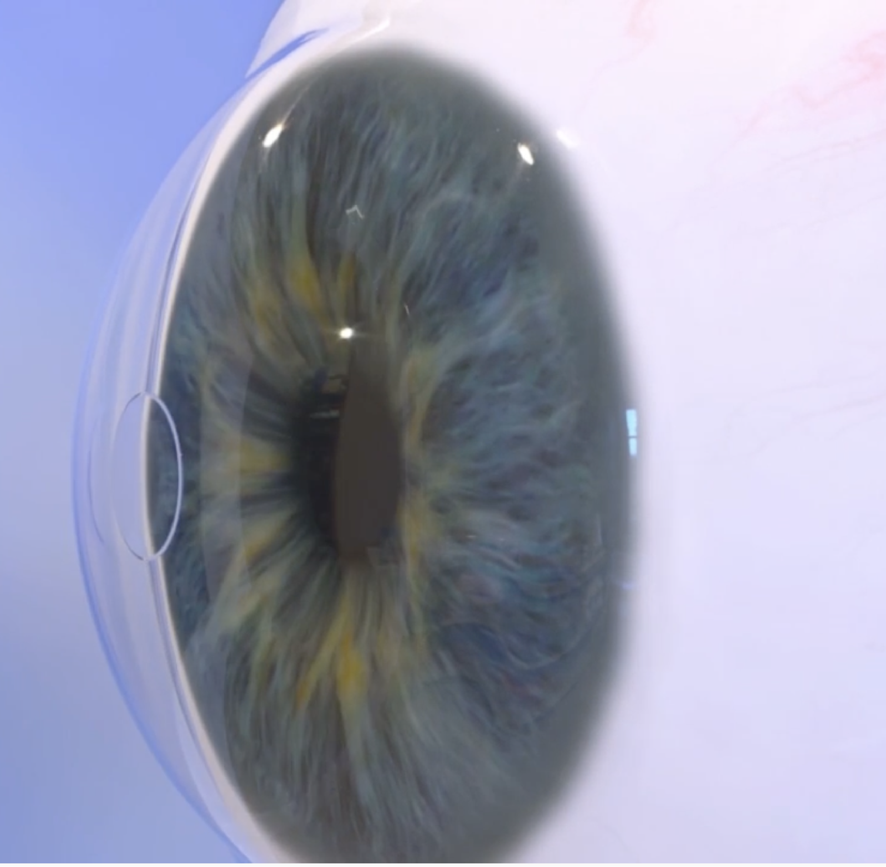
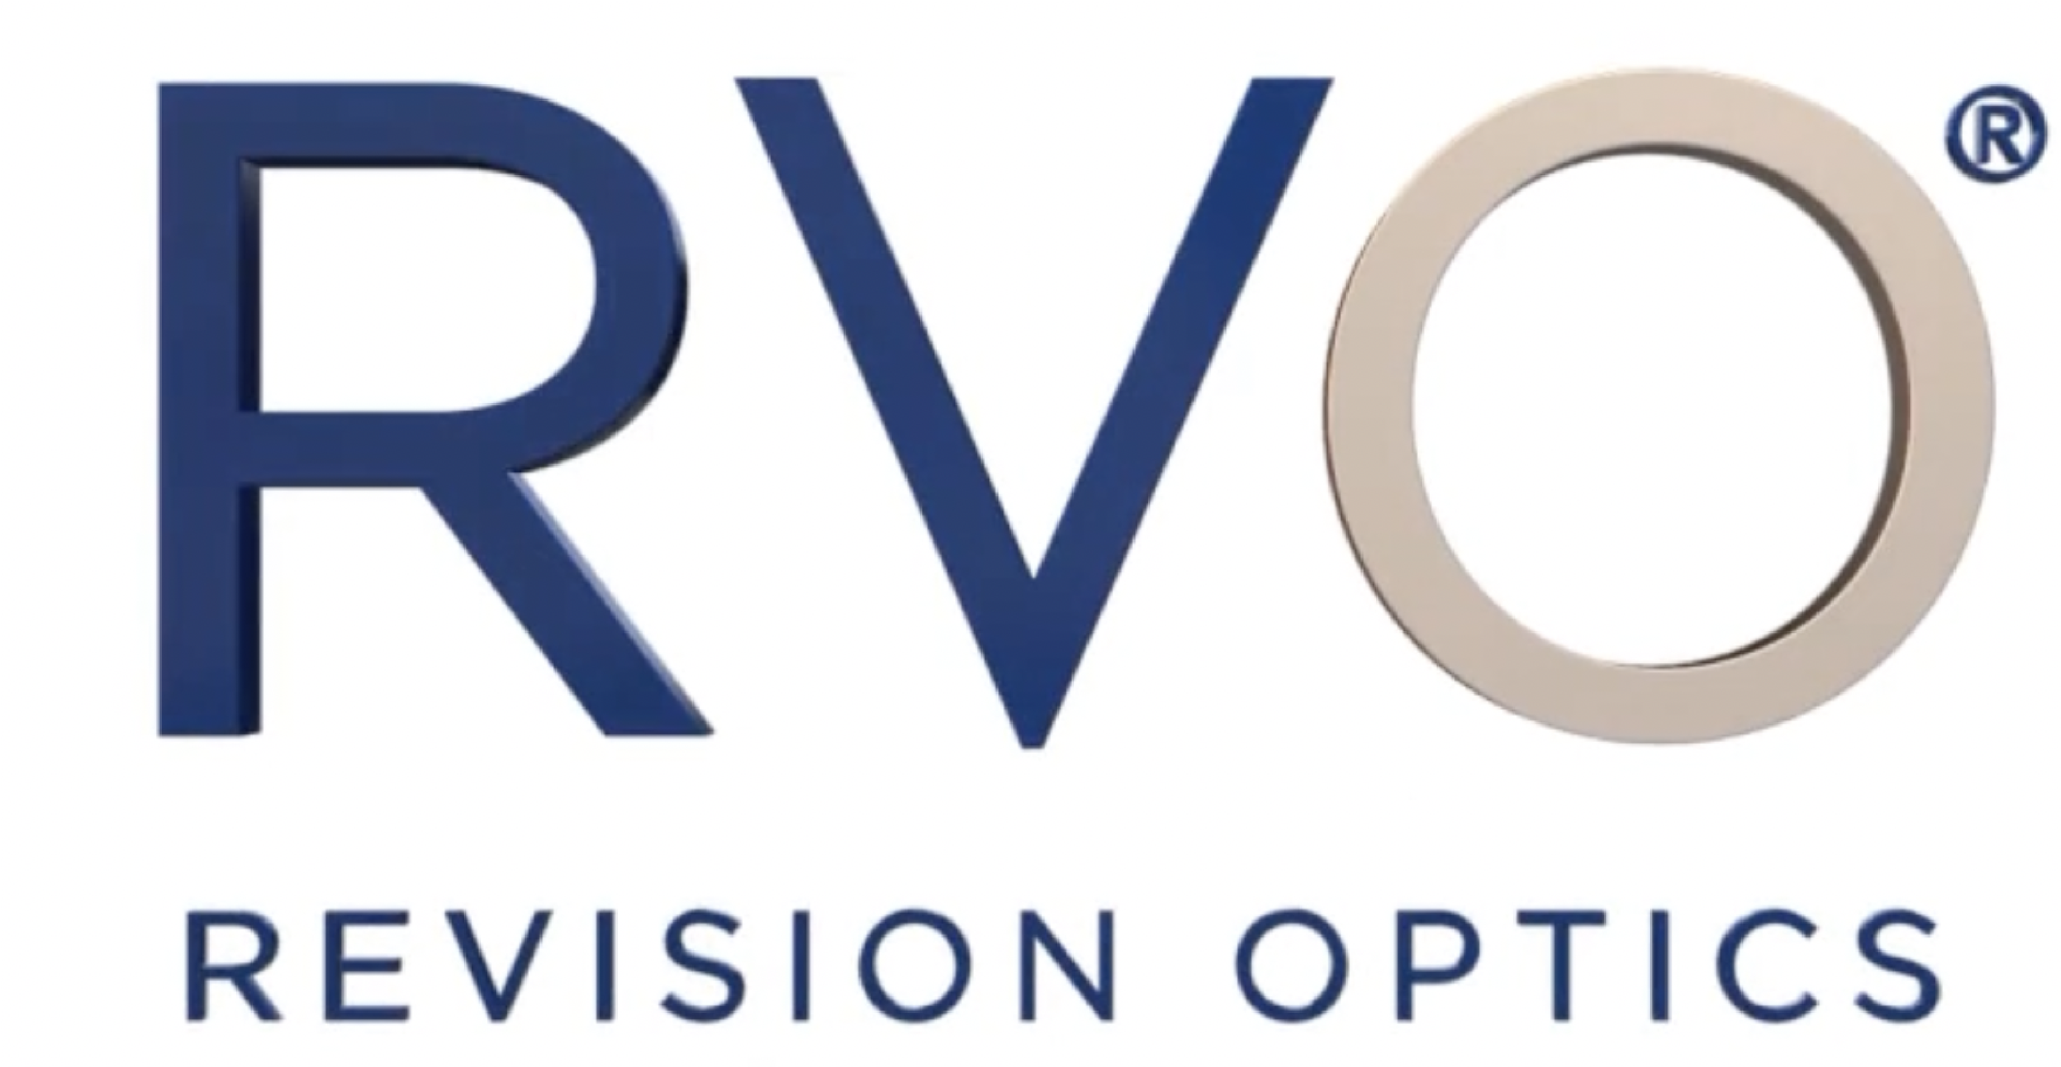


Slide 2
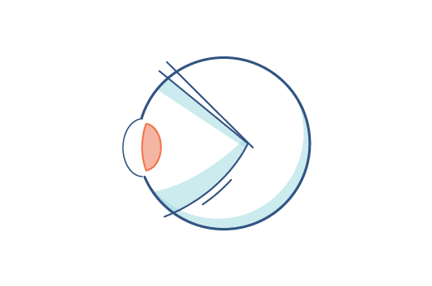







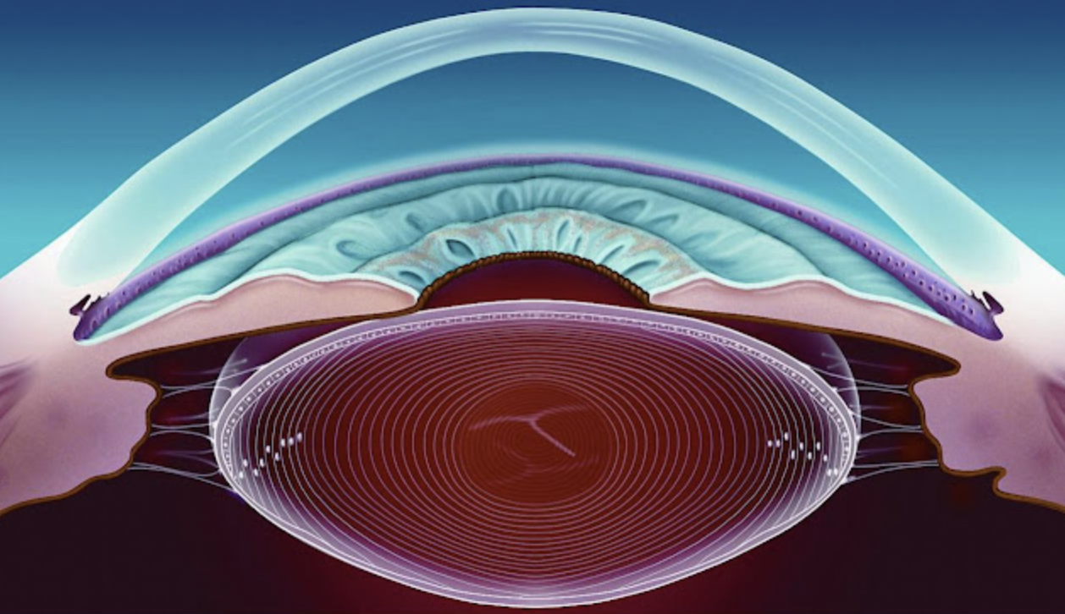

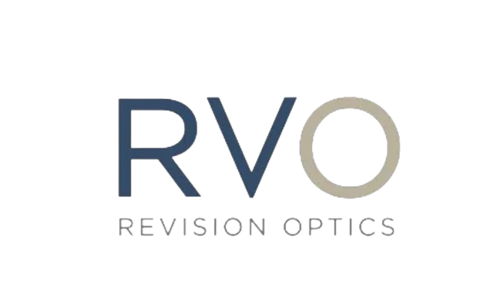
Problem statement
What is Presbyopia?
What does it look like?
20+
10cm
What does it look like?
20+
10cm
40+
25cm
40+
25cm
60+
1m
60+
1m
6.5cm
6.5cm
Presbyopia is the gradual loss of near-focusing ability that occurs with age.
Symptoms

Slide 3
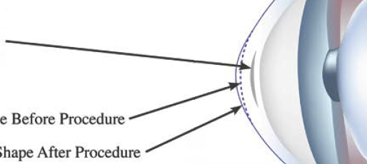
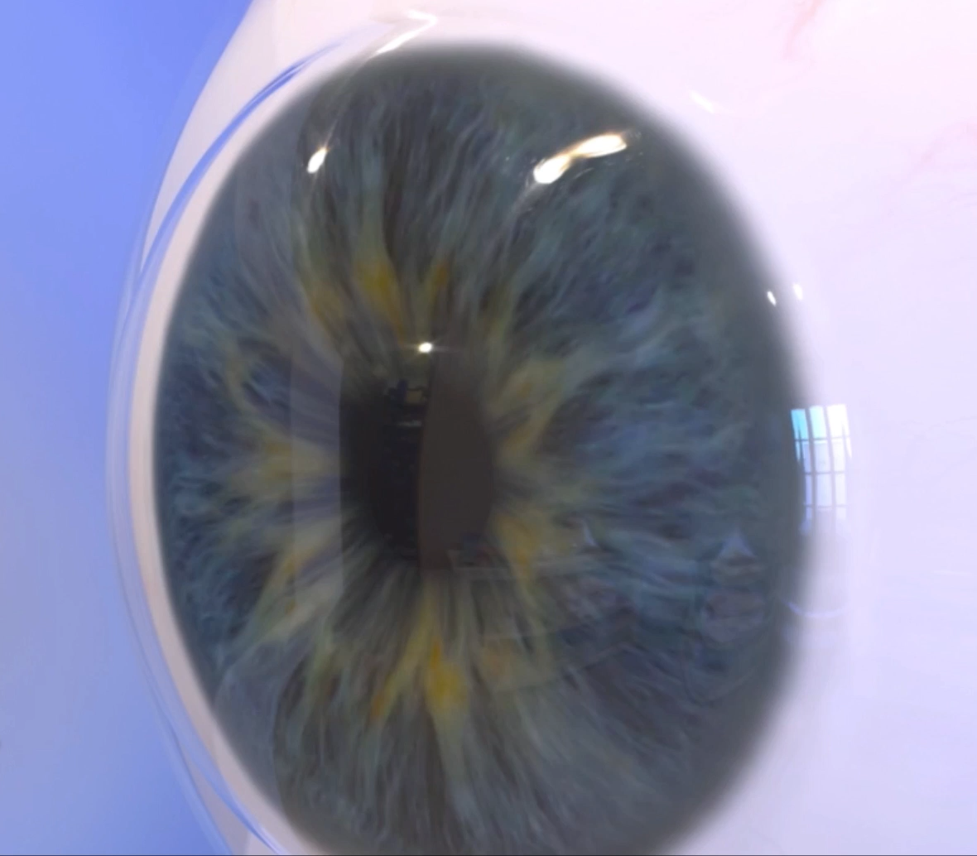
The RVO Solution
Raindrop near vision inlays
Change anterior curvature of cornea
Cornea shape before procedure
Cornea shape after procedure
Patented technology
FDA approved in 2016
Fast procedure femtosecond laser flap
People at 41 – 65 age without other refractive errors like astigmatism or myopia
2 mm Diameter 30 𝜇m Thick
Hydrogel 80% Water

Slide 4
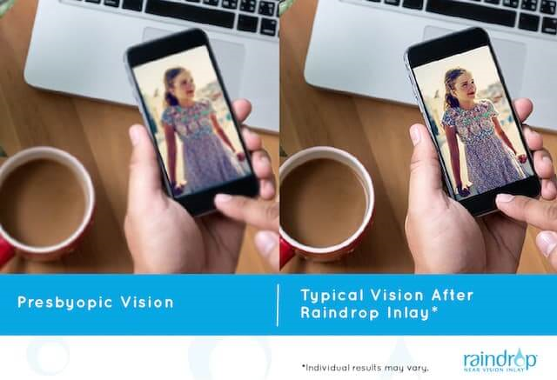
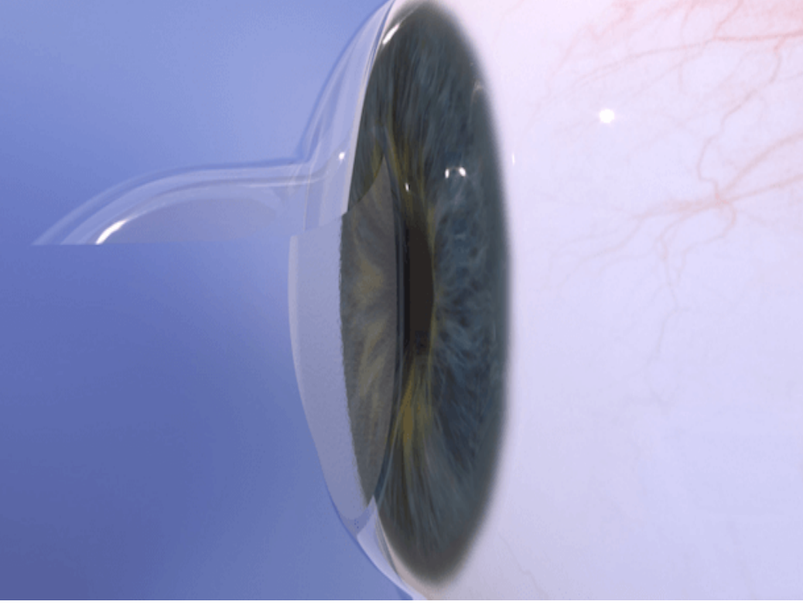
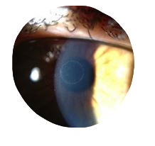
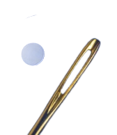
The RVO USP’s
Raindrop near vision inlays
Improves both near and intermediate vision
No need for reading glasses
Placed in one eye only under femtosecond laser flap
Quick and simple 10 min procedure
Removable
Smaller than the eye of a needle and cosmetically clear
Transparent high light transmission

Slide 5



Business Model
Doctors
Patients
RVO distributes the raindrop inlays to affiliated ophthalmologists or sell to distributors
Affiliated ophthalmologists get contacted by the patients through RVO website based on their location and availability
Patients pay around 4000 and 5000$ for the procedure (not reimbursed by health insurance)

Slide 6
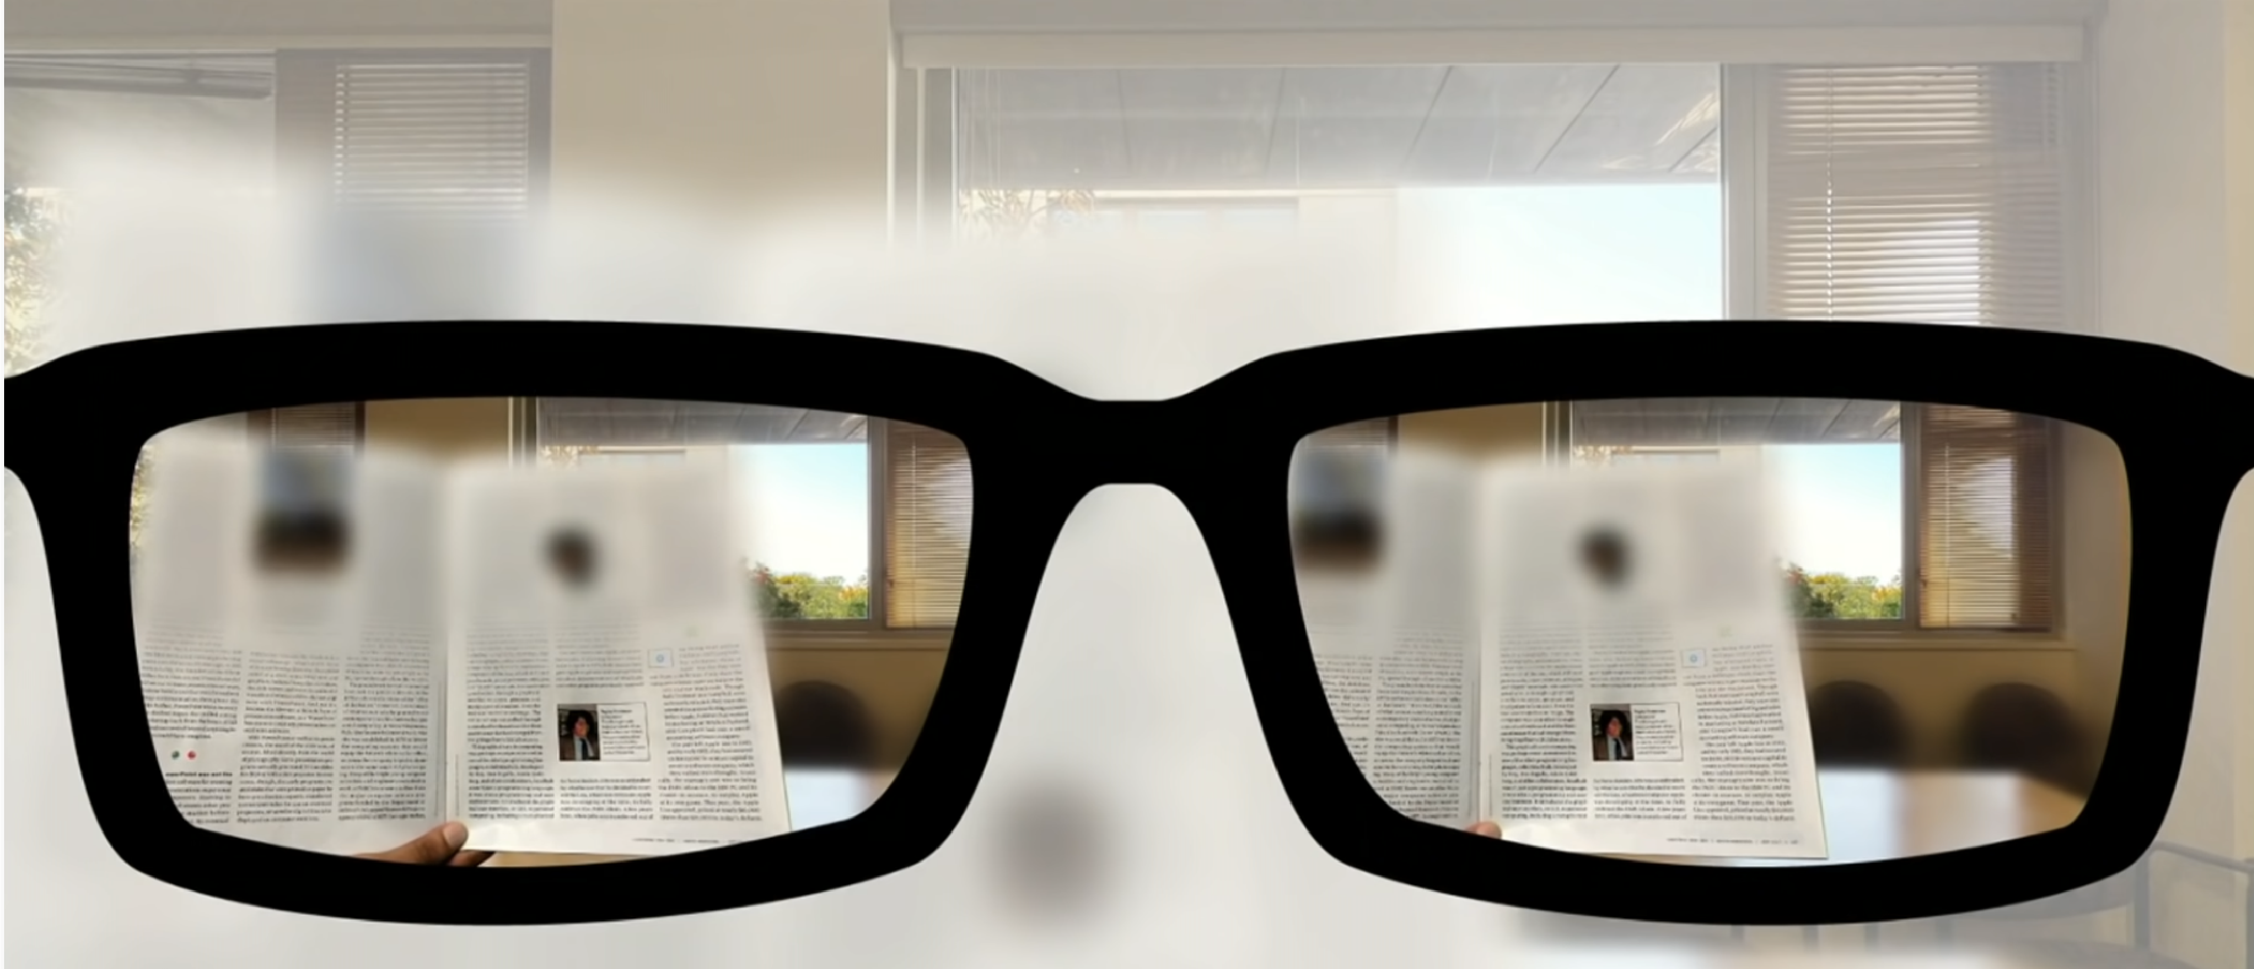

Goodbye Reading Glasses

Slide 7
FAILED or SUCCESSFUL
STARTUP?

Slide 8
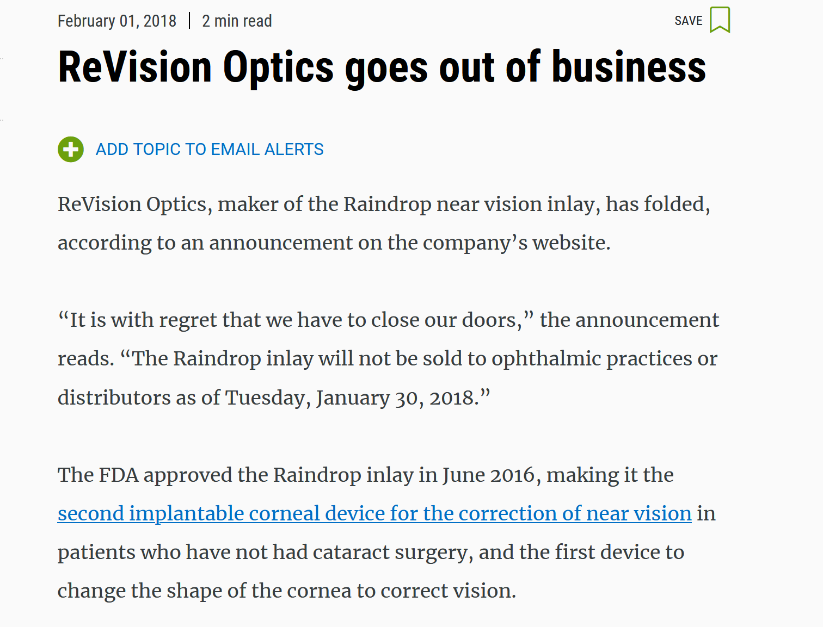
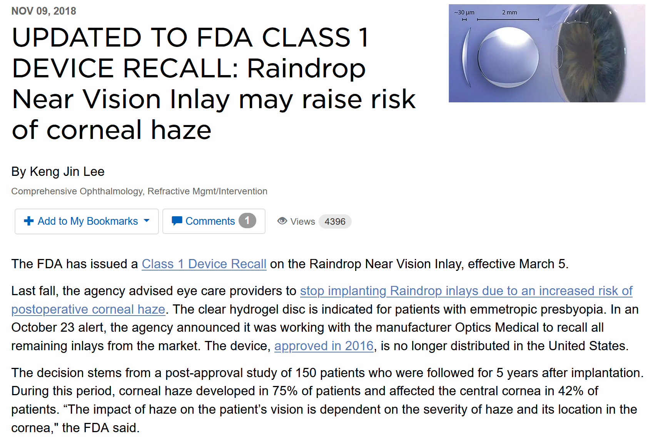
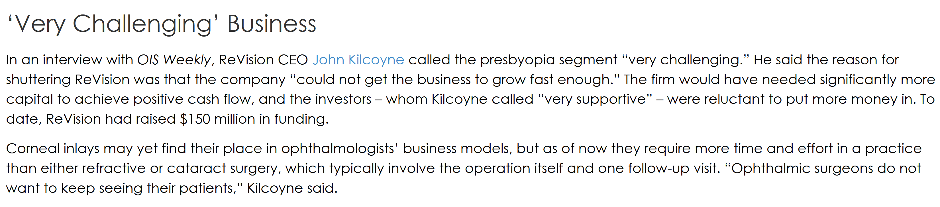
RVO FAILURES!

